Slide 1
Driver's Facial
Expression Recognition
Using Global Context Vision Transformer · DFER-GCViT
Saadi et al., IEEE CVMI 2023
Srimonchaari Padmanabhan Babu · Mat No: 5012061

Slide 2
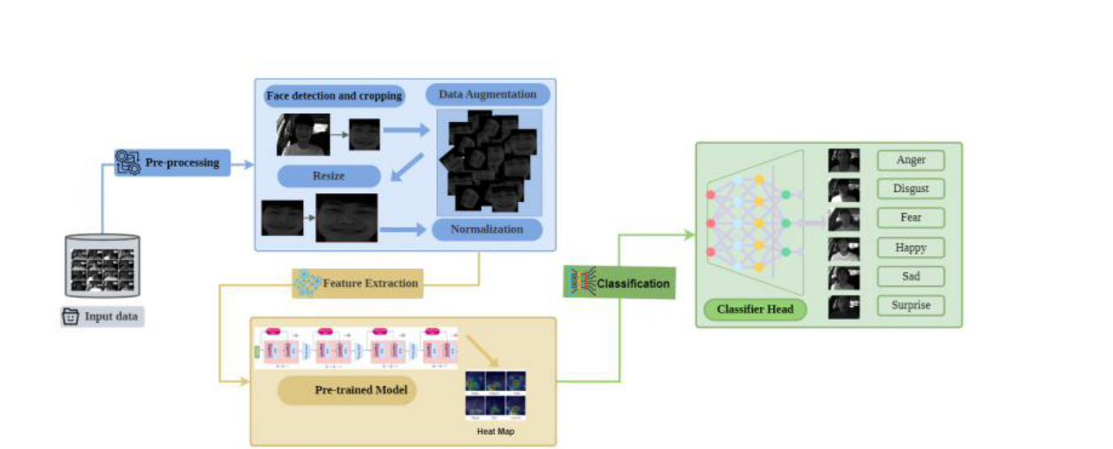
THE PAPER
Drivers show emotions.
Cameras should read them accurately.
The Gap
Paper's Proposed Pipeline
Most models fail under real-world driving conditions — occlusions, poor lighting, head-pose changes
CNNs miss global facial context; they only see local patches
Standard ViT needs large datasets — not available for driver scenarios
GC-ViT captures both local and global features, uses transfer learning to work on small data
Fig. 2 — General workflow, Saadi et al. 2023
1 / 4

Slide 3
THE ARCHITECTURE
Three steps from raw image
to predicted expression.
01
02
03
Pre-process
Extract Features
Classify
Detect face with MTCNN, crop to facial region
Augment: flip, rotate, affine, Gaussian blur
Resize to 224 × 224, normalise pixel values
Pre-trained GC-ViT backbone (ImageNet weights)
4 stages of local + global self-attention
Global Query Generator produces context tokens
Original fc layer replaced with new head
FC → BatchNorm → ReLU → Dropout → FC
Output: 6 expression classes
2 / 4

Slide 4
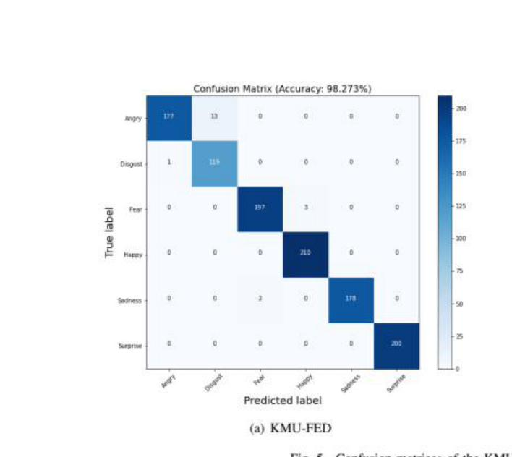
RESULTS — KMU-FED
98.2%
accuracy on KMU-FED
outperforms all compared methods
Method
Accuracy
Hierarchical WRF
94.7%
CCNN
97.3%
Modified SqueezeNet 1.1
83.4%
DFER-GCViT (ours)
98.2%
Happiness & Surprise — zero misclassifications
Anger vs. Disgust — main confusion point
Confusion matrix — KMU-FED (10-fold CV, Saadi et al. 2023)
3 / 4

Slide 5
MY EXTENSION
What if the driver
wears sunglasses or a mask?
← eye region blocked (sunglasses)
What I will do
Reimplement DFER-GCViT on KMU-FED only
Add synthetic occlusions to images: black or blurred rectangles over the eye or mouth region
Train two models — Baseline (clean data) vs. Robust (trained with occlusions)
Evaluate both on clean and occluded test sets
← mouth region blurred (mask)
Accuracy
F1-Score
Accuracy Drop (%)
clean vs. occluded test set
macro, clean vs. occluded
clean accuracy − occluded accuracy

